Slide 1

Gold Metal Price Prediction Project
BY Under Guidance
Sarita : Rajshekar
Anil Jhadhav
Sai Praneeth

Slide 2
Business Objective:
Data provided is related to gold prices. The objective is to understand the underlying structure in your dataset and come up with a suitable forecasting model which can effectively forecast gold prices for next 30 days.
This forecast model will be used by gold exporting and gold importing companies to understand the metal price movements and accordingly set their revenue expectations.

Slide 3
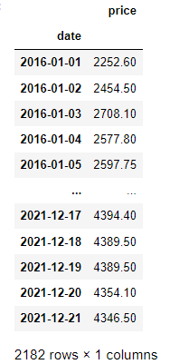
Data Set :The Data Provided to us with 'Date' & 'Price' Features to Predict the Forecast of the Price for next 30 days after 2182 days of Data.
Date Feature : From 01-01-2016
To 21-12-2021
Have to predict the next 30 days of Price of Gold Metal

Slide 4
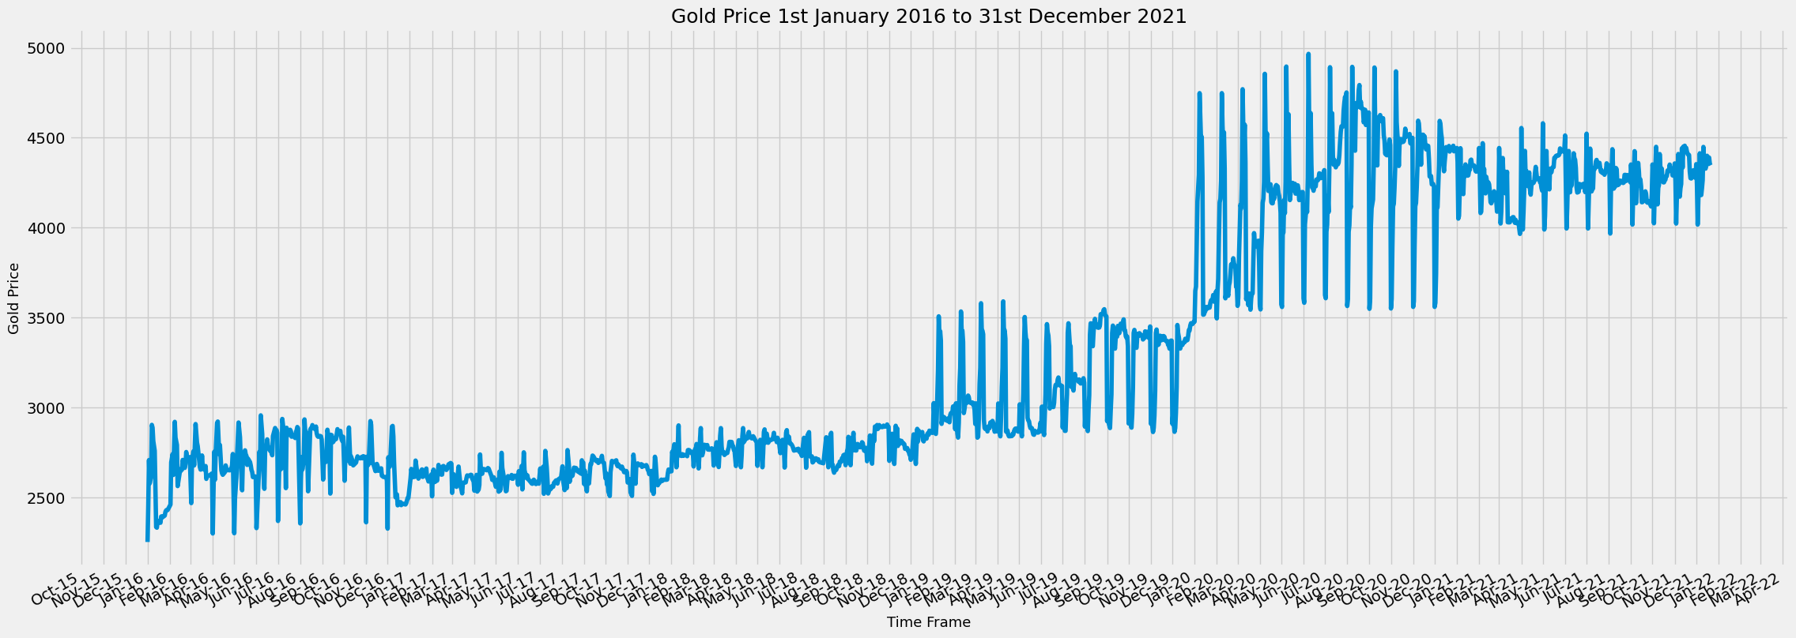
Graph of Gold Price VS Time frame

Slide 5


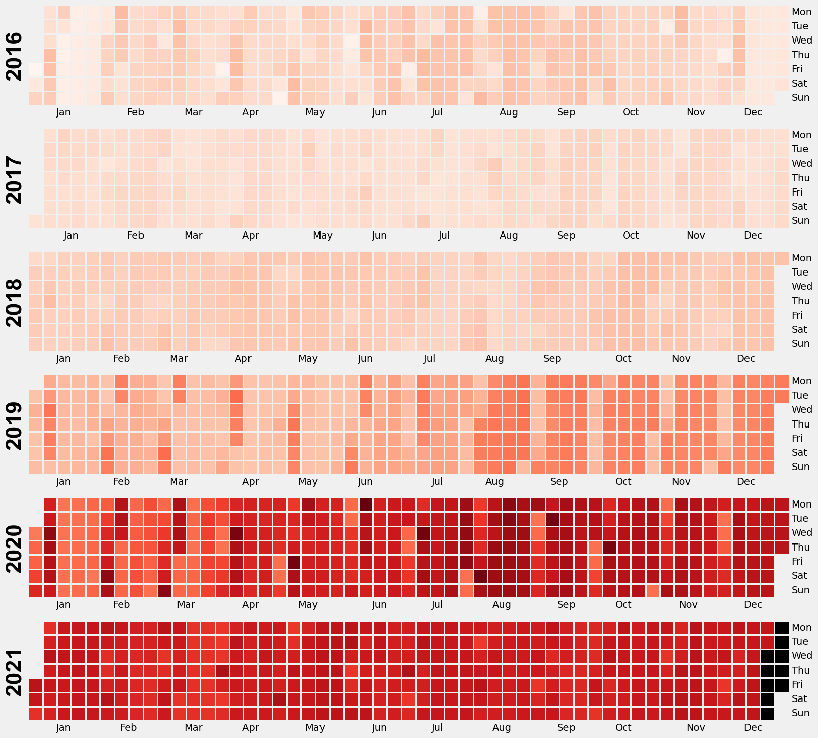

Calendar of Gold Price from Dataset
z
This codes Describe the Price of the God during the years in Data Set
NOTE :Lighter colour indicates lower and dark colour indicates higher Price

Slide 6
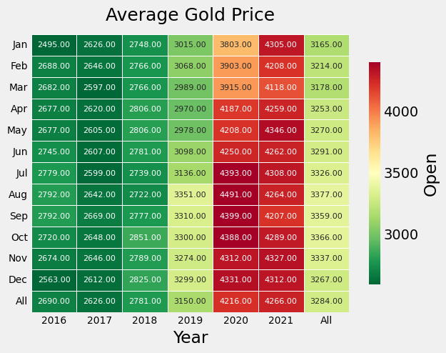
Average Gold Price in a month

Slide 7
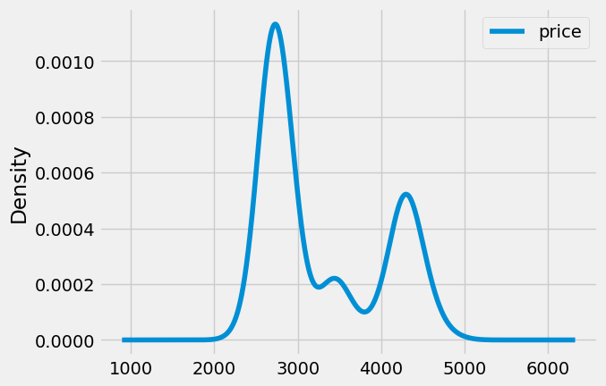
Density Distribution of Price

Slide 8
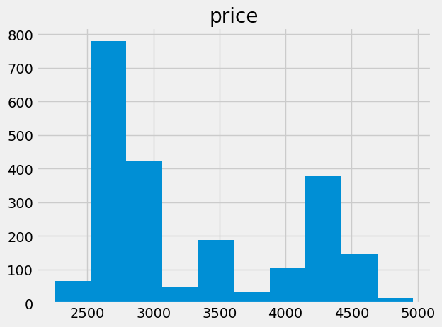
Price Distribution of the Gold in INR
z

Slide 9
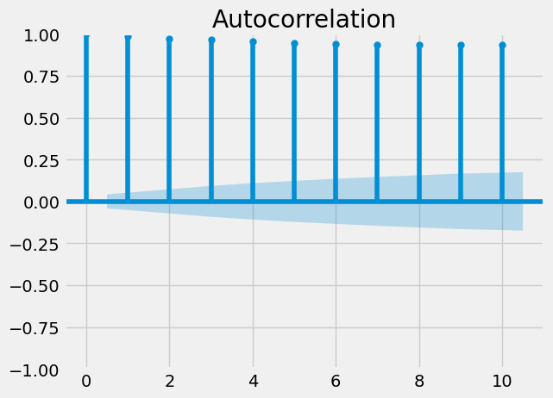
Auto Correlation Graph

Slide 10
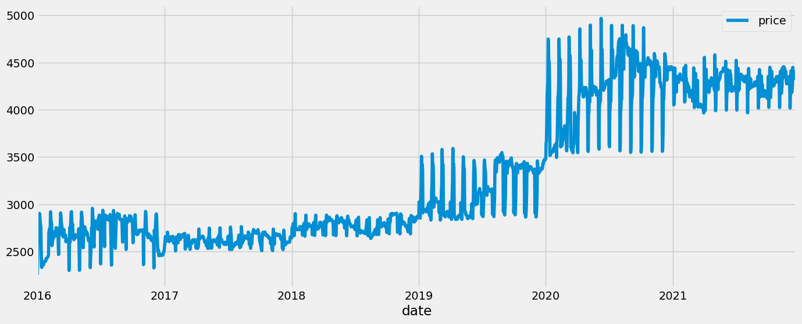
Overall Graph of the Cost Distribution after forecasting

Slide 11
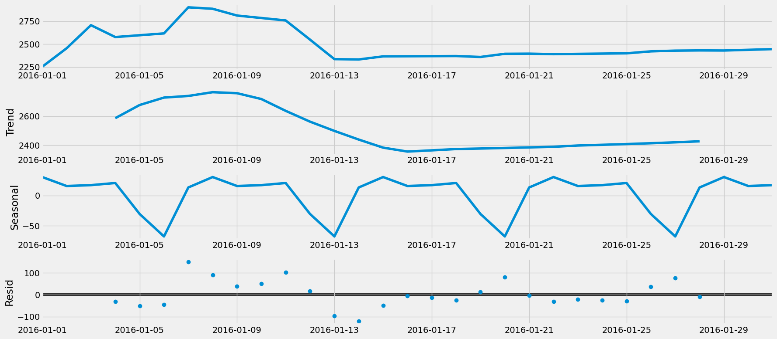
Analysis of Trends in year wise

Slide 12
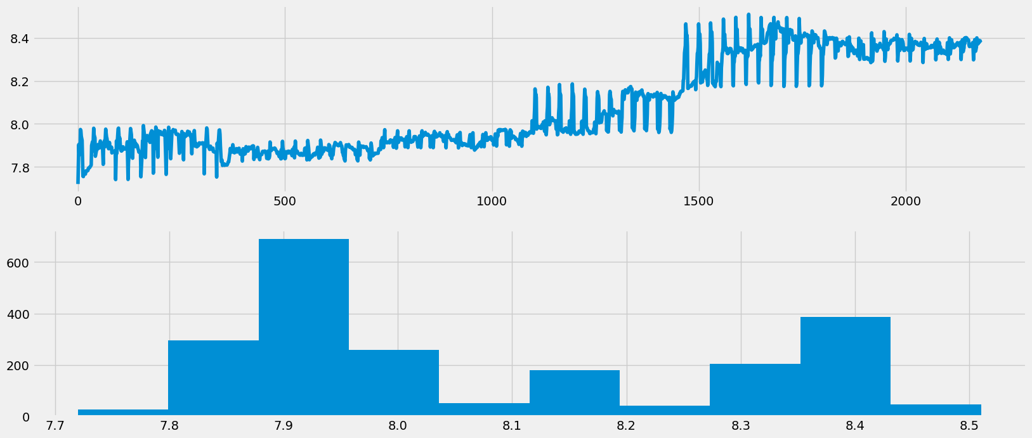
BOXCOX Representation of Data with Forecasted Price

Slide 13
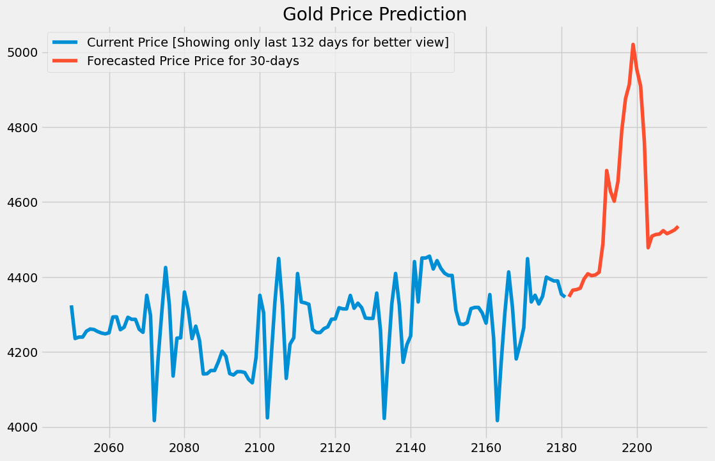
Prediction of Gold Price for 30 days from Previous data

Slide 14
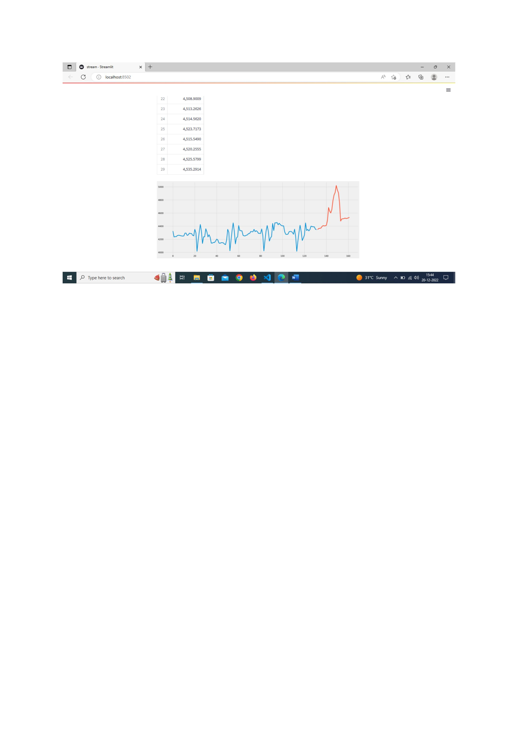
Deployment Page of the Prediction

Slide 15
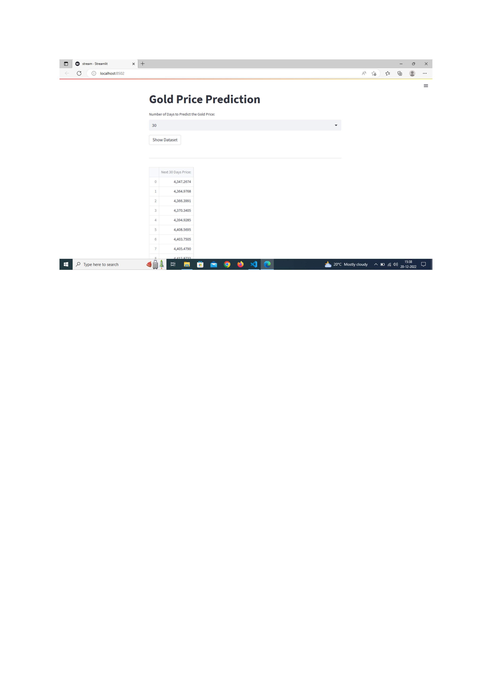
Deployment Page of the Prediction ​of Data

Slide 16
THE END
z

